Slide 1

WEB ANALYTICS
User community status of Stark Overflow
Group: Team 6
Andi Zheng Yicheng Ren Kuan Jiang Tiange Li

Slide 2
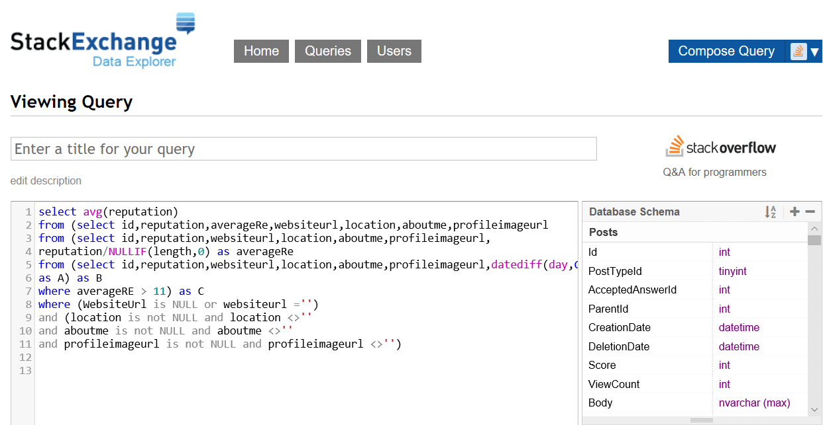
Data collection
Difficulty we met in our project:
9737247 users to analyze, difficult to filter appropriate users
When analyzing interaction, complicated queries like “post as p1, post as p2, badge as b1 badge as b2” may cause a time expiration.
Hard to check accuracy
the dataset updates every 4 months.
(updated (2018-12-3))
https://data.stackexchange.com/stackoverflow/query
29 tables in the database
Mainly use: posts, users, badges, tags, posttags, comments, votes, postwithdeleted.

Slide 3
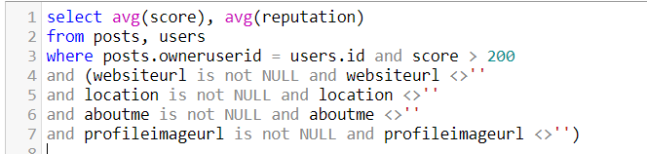
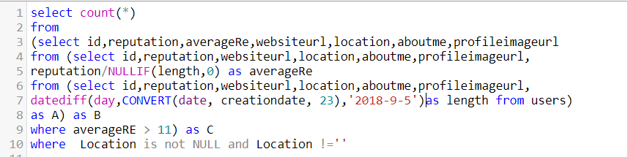
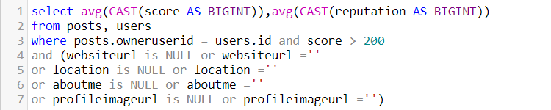
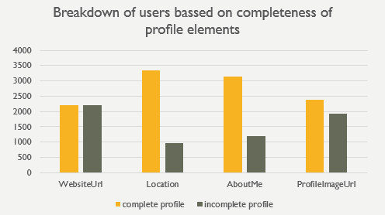
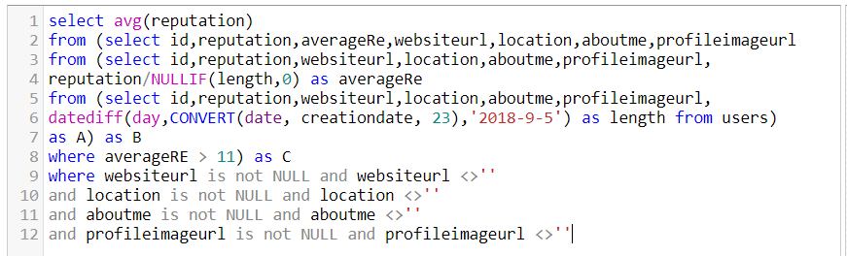
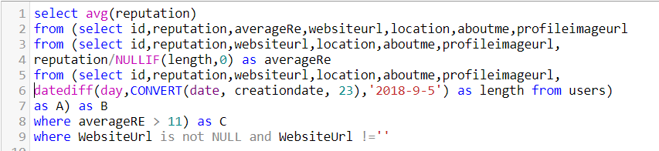

user profile on participation

Slide 4
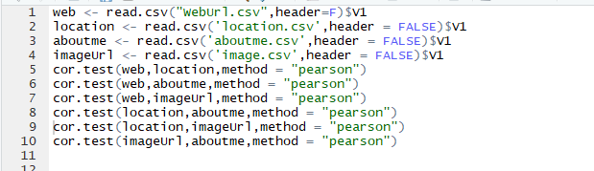
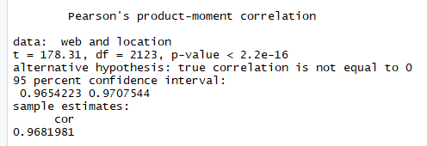
PEARSON CORRELATION
 | WebUrl | Location | AboutMe | ProfileImageUrl
WebUrl | 1
Location | 0.9681981 | 1
AboutMe | 0.9357681 | 0.9912816 | 1
ProfileImageUrl | 0.9717663 | 0.9404273 | 0.8914085 | 1

Slide 5
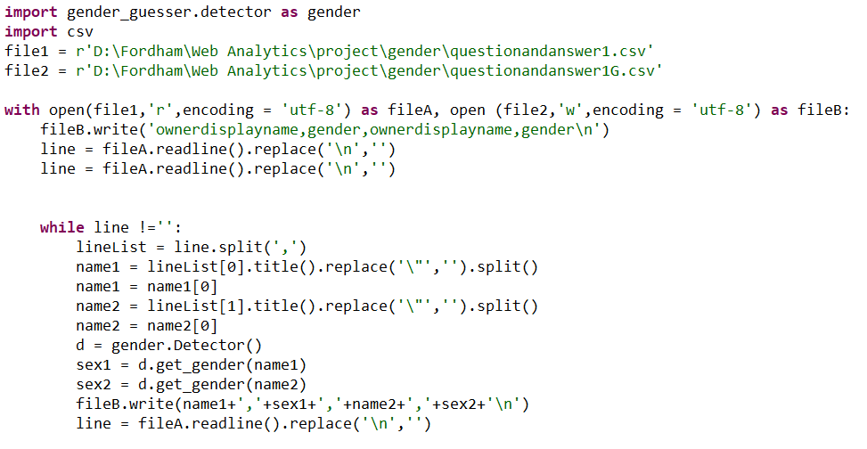
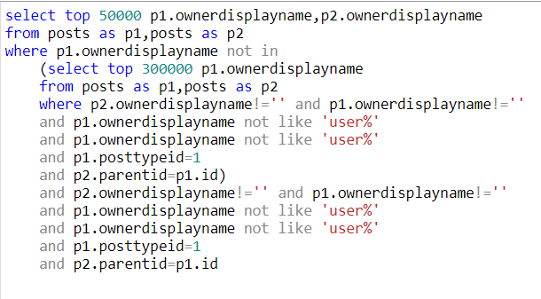
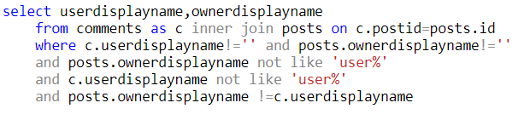
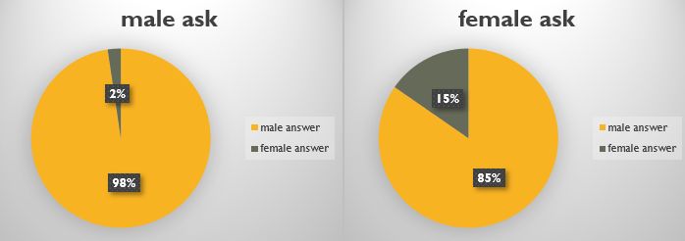
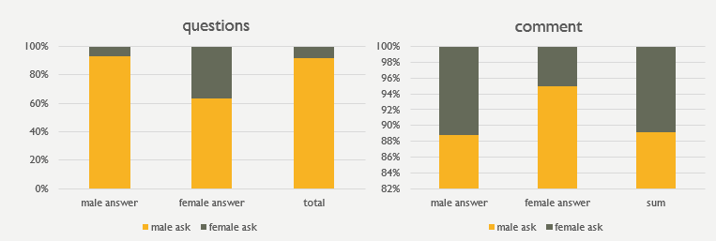
GENDER ？
26.72% accuracy
Random select: 300000 to 100000
Conclusion:
Female mainly asks
No obvious bias in no answer questions and comments
Female exists peer parity when answering female questions
Low interaction rate between male and female

Slide 6
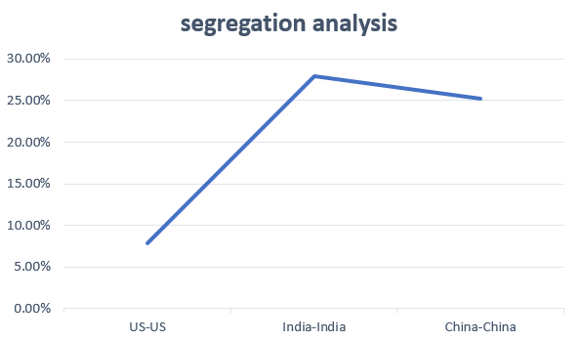
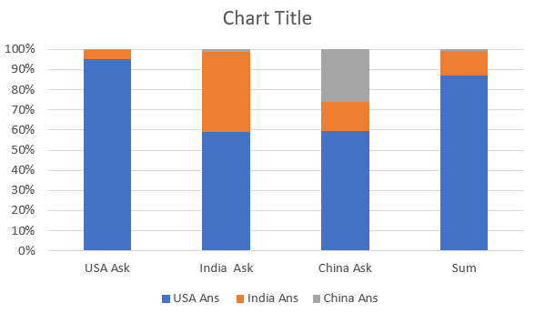
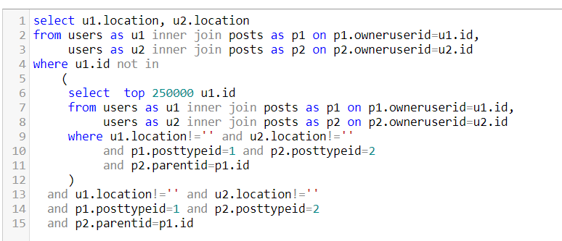
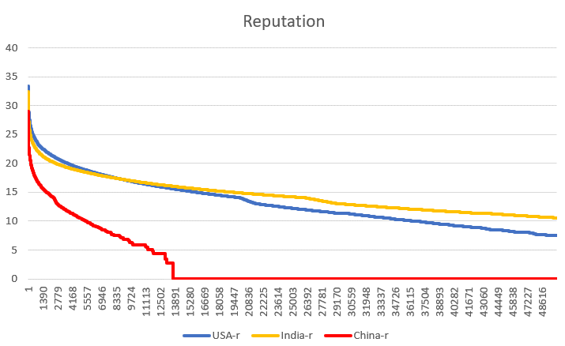
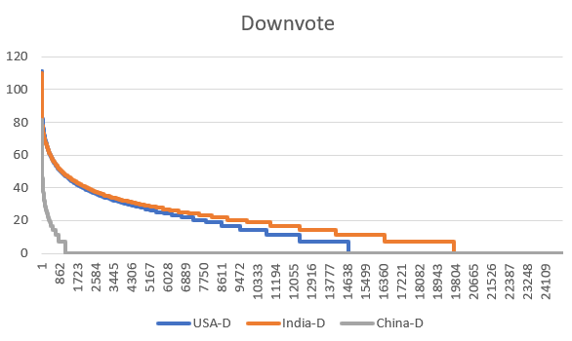
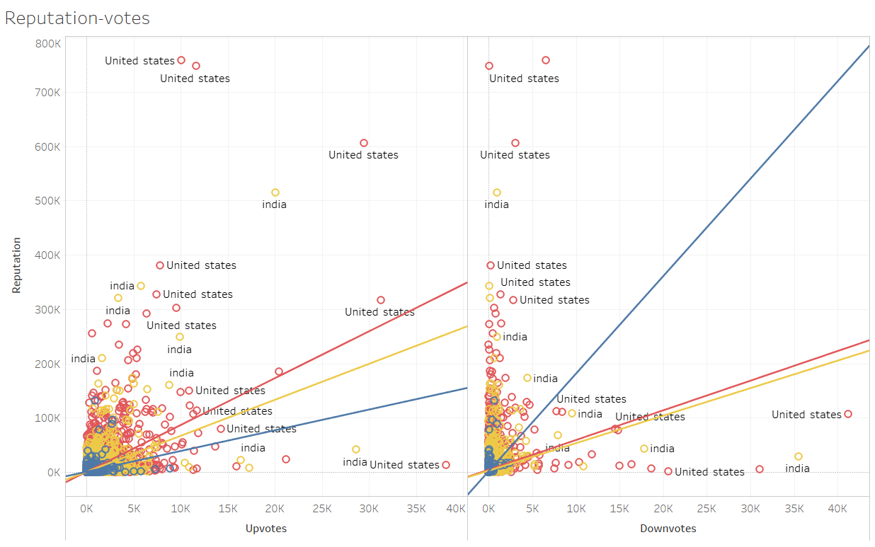
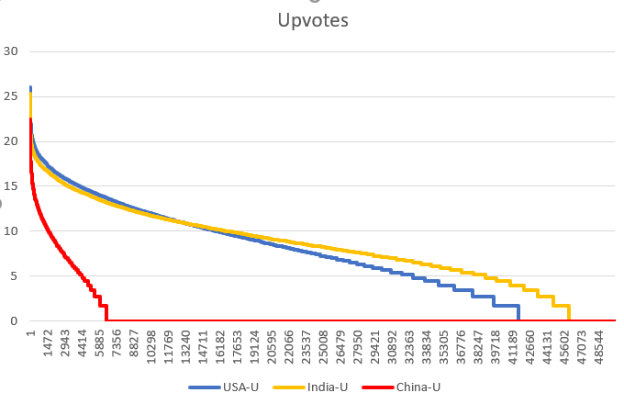
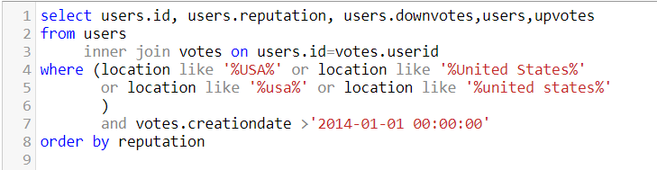
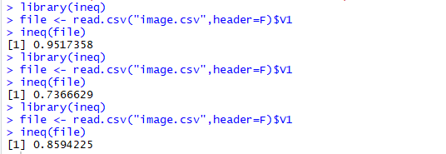
Location
Random select: 50000 in 300000
Gini index score
China
India
Conclusion:
Indian users’ reputation distribution is the most balanced one
User increase interaction rate with native users, especially Indian.
Chinese are the weakest group
USA

Slide 7
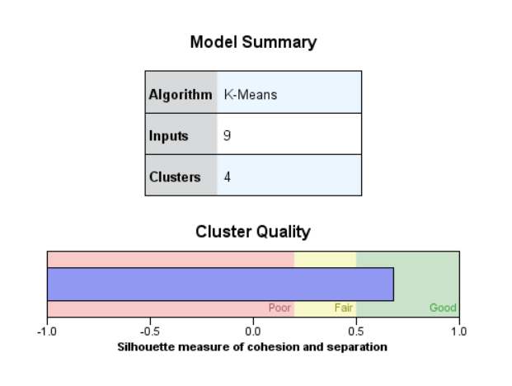
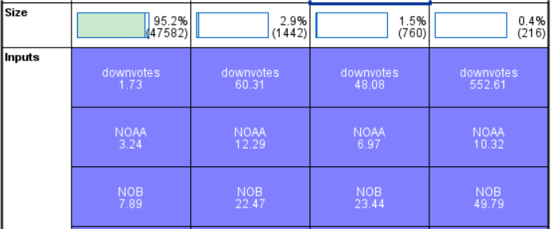
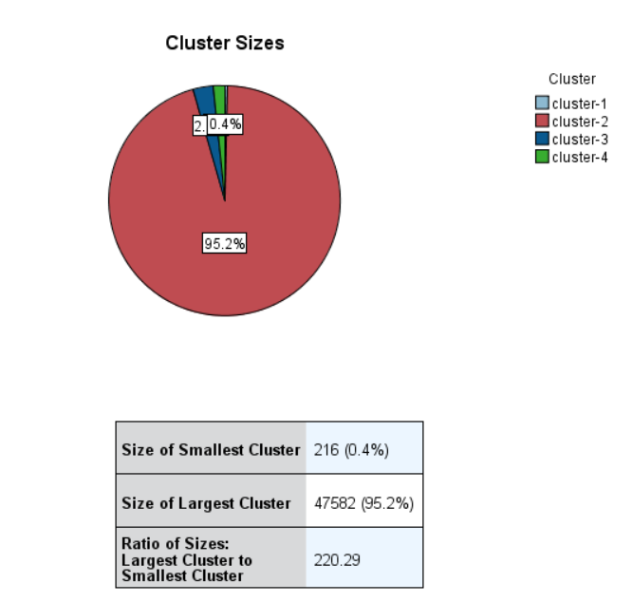
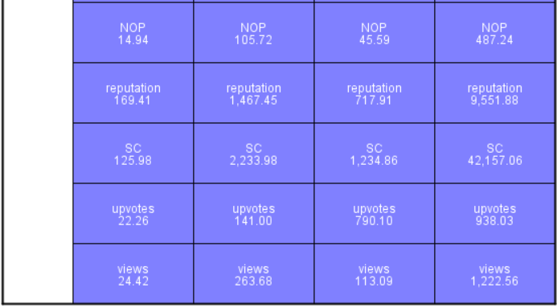
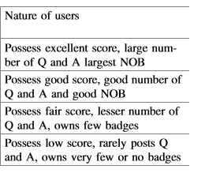
How much experts contribute?
Who are experts?(tag: badge, overall: reputation)
category | cluster | average performance | number of users
experts | 4 | 94.7790 | 216
Surpassing users | 2 | 53.0177 | 1442
Active users | 3 | 37.6498 | 760
ordinary users | 1 | 15.3287 | 47582

Slide 8
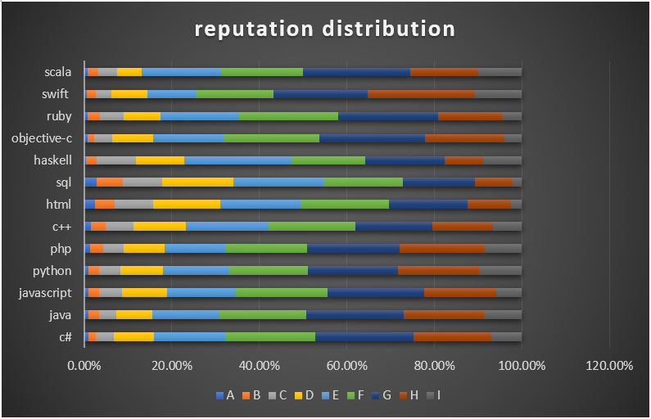
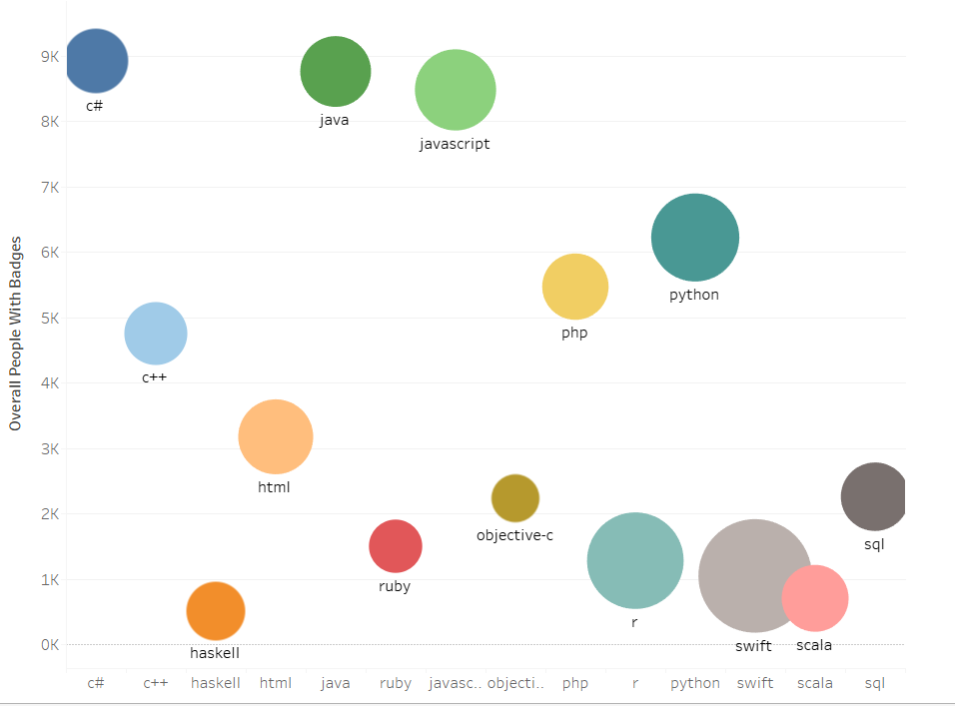
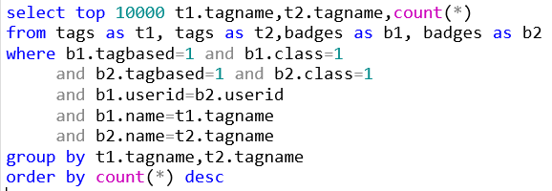
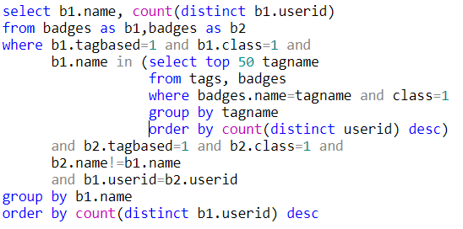
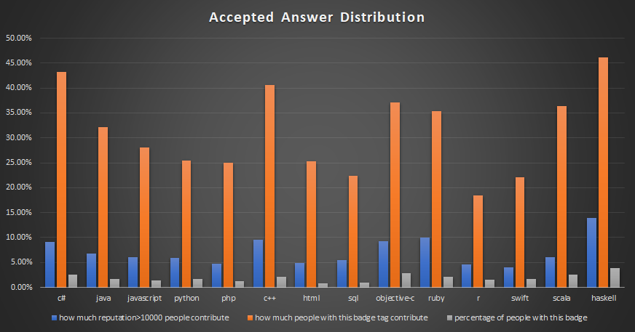
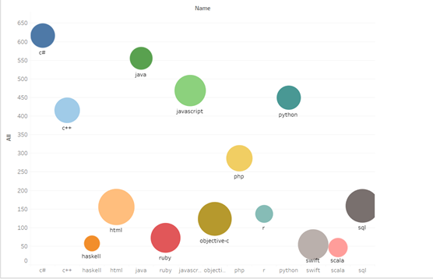
Expert analysis:
2018 increased expert
cross-tags expert

Slide 9
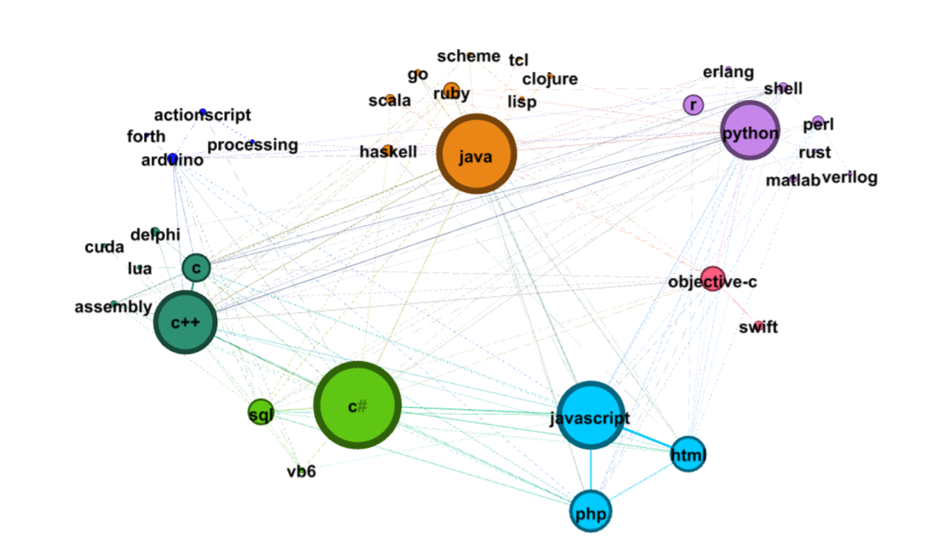
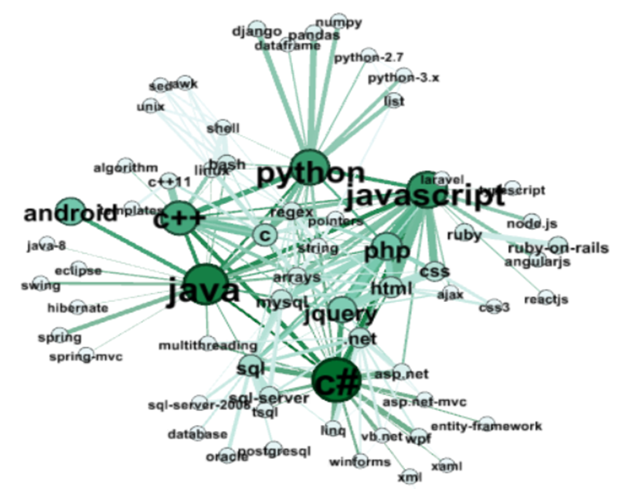
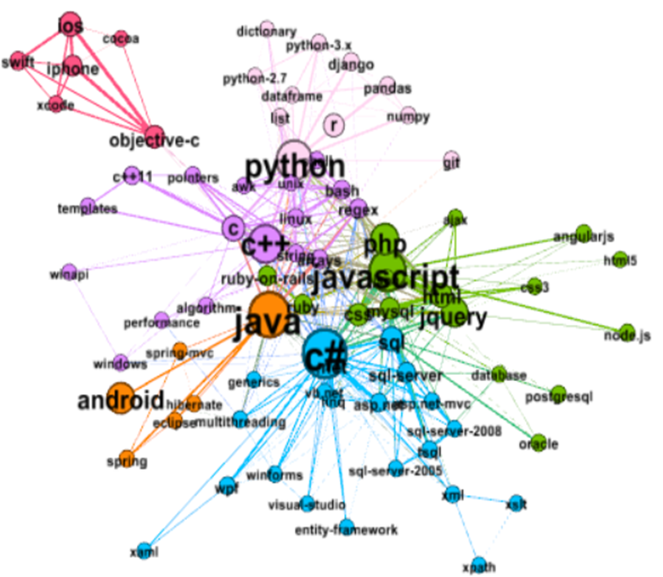
Gephi visualization
Degree
Betweenness
Closeness
Community | Programming Languages
1 | Objective-C, Swift,
2 | C#, Sql, VB6, xml
3 | Javascript, PHP, HTML,
4 | Python,R, Shell, Erlang, Perl
5 | C++, C, linux, Delphi, Assembly
6 | Java, Scala, Ruby, Haskell, Scheme, Go, Lisp

Slide 10
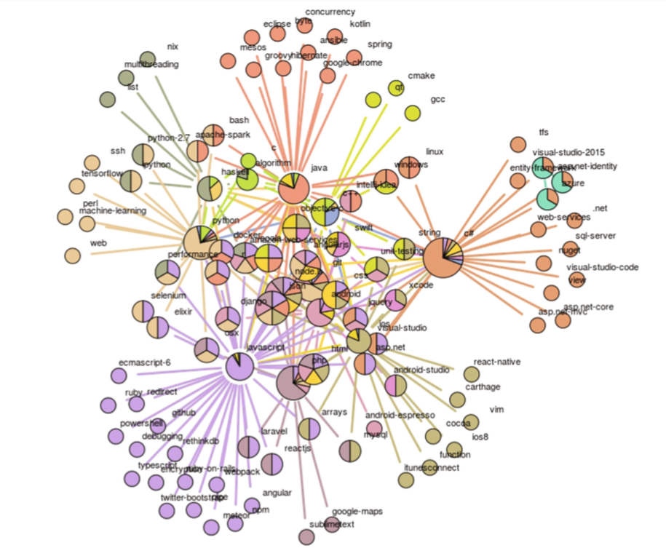
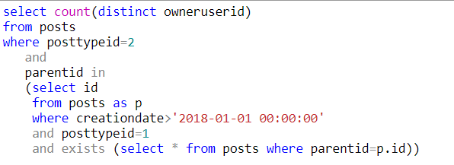
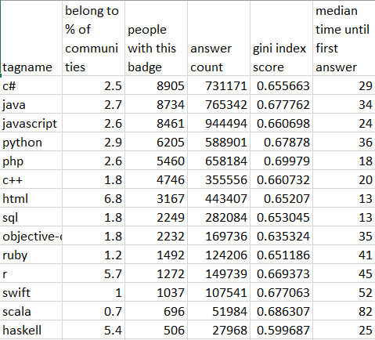
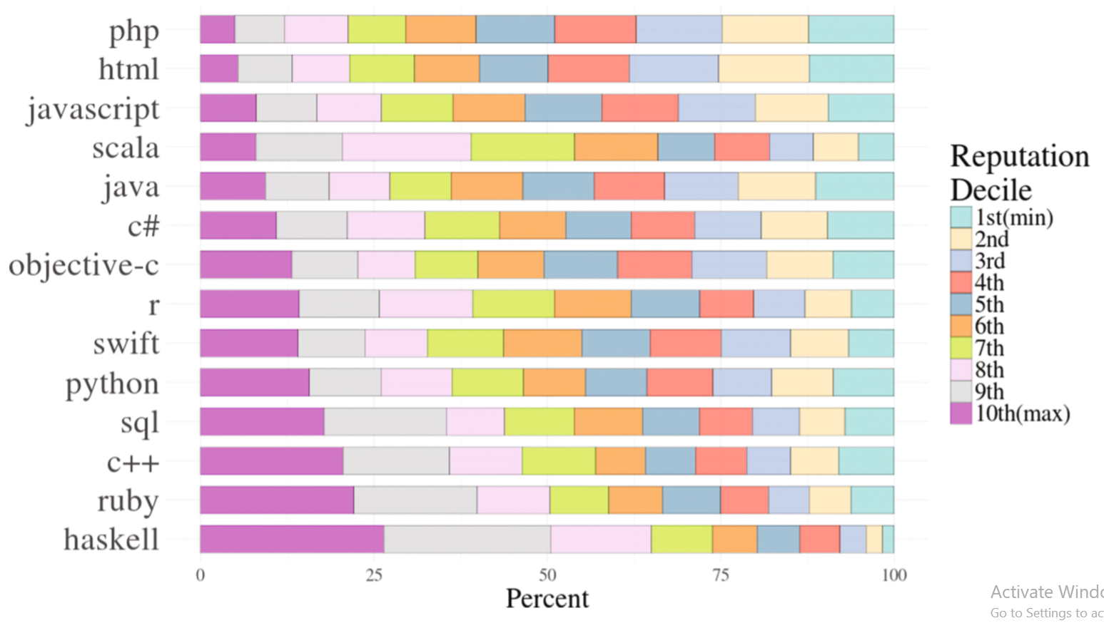
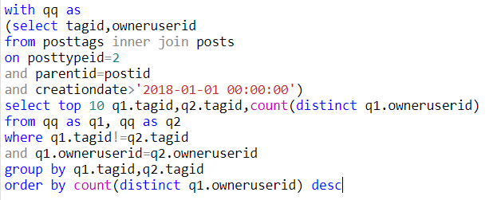
R “linkcomm” package
Community detection algorithm
Scale free network?

Slide 11
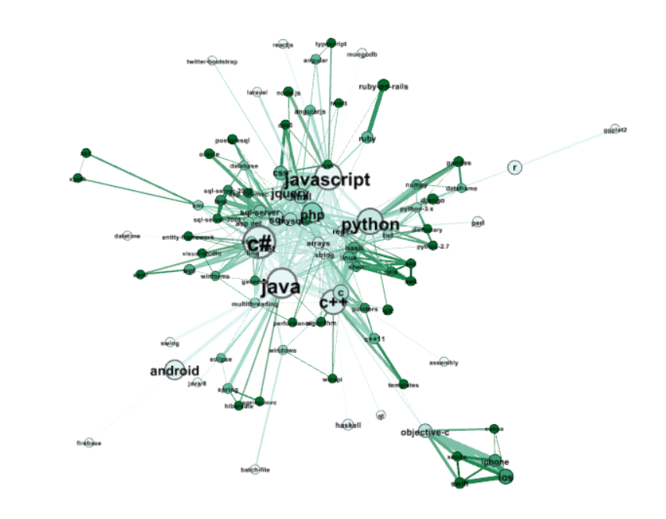
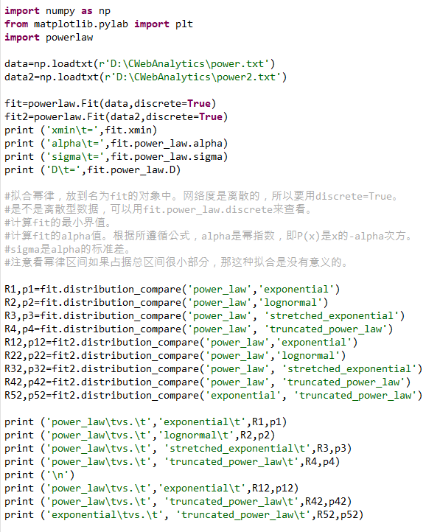
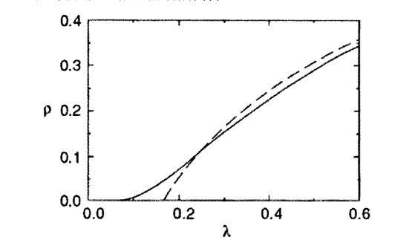
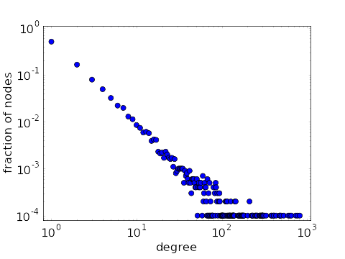
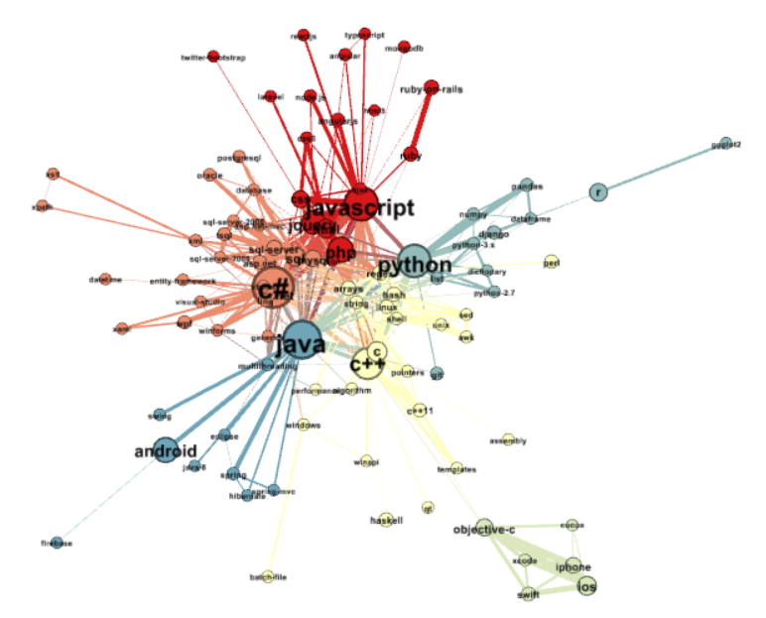
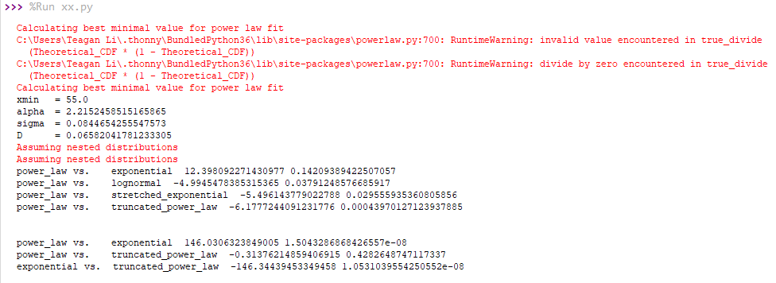
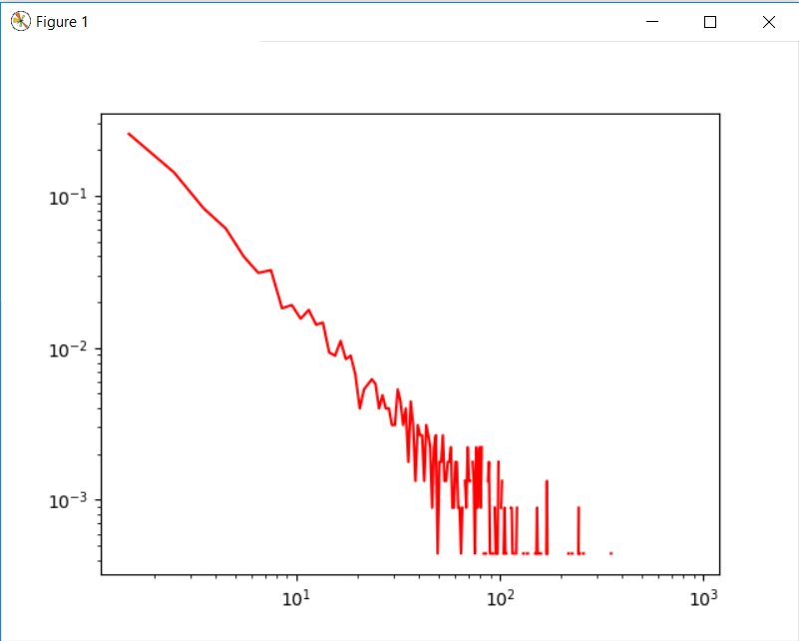
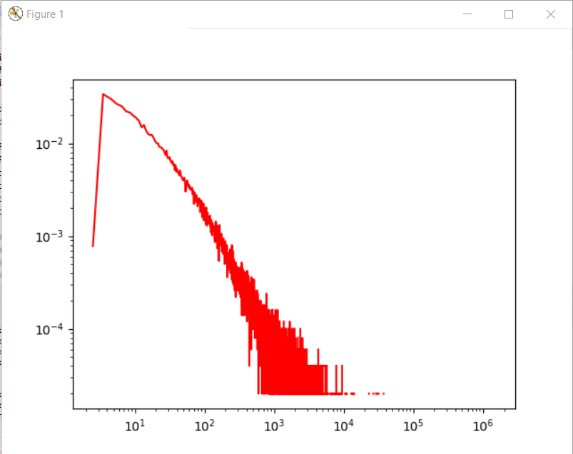
Dynamics of communication
Description | Characteristic
Avg. Weighted Degree | 9.148
Network Diameter | 5
Graph Density | 0.069
Modularity | 0.417
Connected Components | 14
Avg. Clustering Coefficient | 0.754
Avg. Path Length | 2.561
Spread efficiency with density of infection
Clustering coefficient
Power law fit
Mathinsight.org
Modularity class

Slide 12

Conclusion
--The overall user community status of SO
Flaw in profile setting
Possible Improvement: adjust mandatory parts, deemphasize “image”
Problems in users interaction
Low interaction between male and female
Low interaction among different countries
Few experts control most of the community
Network effectiveness justification
Unpopular tags are unstable, but knowledge spread across tags is nevertheless effective and strong.

